Slide 1
87V8
Apr. 20, 2016 | Version: 1.5.0
Oliver Wang

Slide 2
Revision History-1
版本号 Version | 变化状态 Status | 简要说明 Brief introduction | 日期 Date | 变更人 Change by
V1.1.0 | A | Create | 2016-02-24 | Oliver Wang
V1.2.0 | A | Add Alipay | 2016-03-03 | Oliver Wang
V1.3.0 | A/D/M | Delete Alipay and add member Log in, 87V8 update, Game update, Pause game, Stop game, Continue game etc. | 2016-03-31 | Oliver Wang
V1.3.1 | A/M/D | Delete game update Manually, Modify member Log in, Delete Like, Delete Pause/Continue game and add pay and continue play, Add Game in progress scenes. | 2016-04-01 | Oliver Wang
V1.4.0 | A/M | According to Berlin and David resolution to add and modify, The main is one Control Panel can control one or more device. | 2016-04-07 | Oliver Wang
V1.4.1 | A/M | According to discussed result with Kim and Harry. | 2016-04-07 | Oliver Wang

Slide 3
Revision History-2
版本号 Version | 变化状态 Status | 简要说明 Brief introduction | 日期 Date | 变更人 Change by
1.4.2 | A/M | 1. First screen show Device and Game at the same time . Game show at 70—80% of space . 2. To select device , need to show 3 mode . One for just by number and name , another’s for show device’s photo and MAP with device. Just show number and name is default . | 2016-04-10 | Oliver Wang
1.4.3 | M/D | Modify device and game layout Delete MAP mode and MAP settings | 2016-04-11 | Oliver Wang
1.5.0 | A | Add username and password input box for member log in. Add pay by Alipay and Wechat. | 2016-04-20 | Oliver Wang

Slide 4
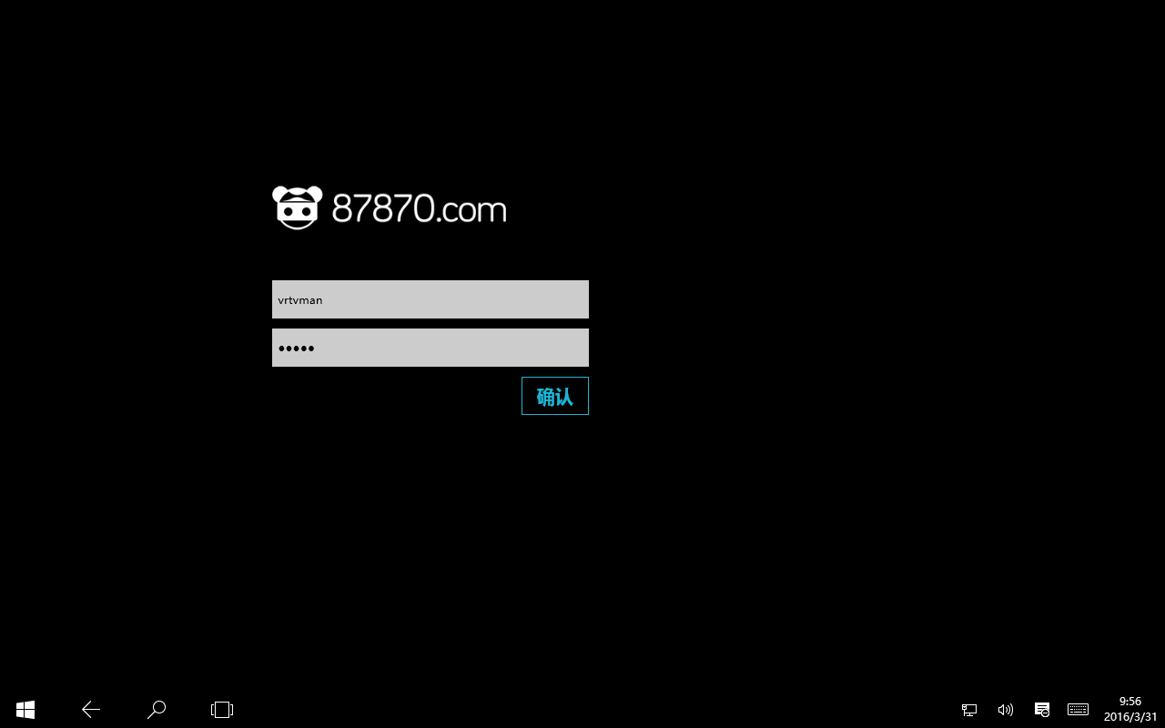
Log in Page
Description
1. | 管理员/店员输入用户名密码，登录87V8客户端 Admin/Staff enter username and password to Log in 87V8(VR World)
2. | 点击“确认”按钮登录 Click “Log in” button to Log in

Slide 5
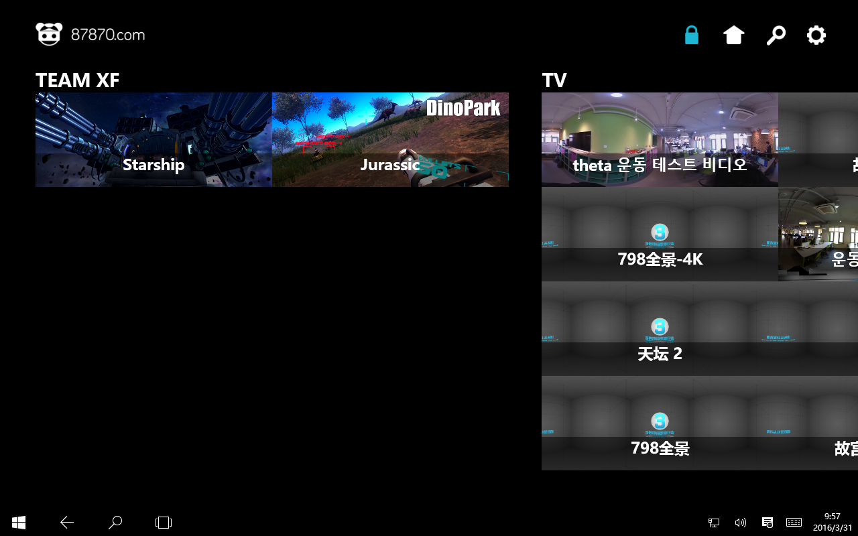


Home Page-Simple mode(Default mode)
Description
1. | 游戏类别列表 Game types list
2. | 游戏列表 Game list 根据选择的类别不同，自动加载对应的游戏内容 According to different type, auto load different game
3. | 上下滑动 Swipe up and down
4. | 设备列表 红色：设备正在运行中 Red: Device is running 黄色：设备暂停使用 Yellow: Device not in service 绿色：设备空闲 Green: Device in service and can be selected 设备分为三种显示模式： Three modes device displayed 简单模式（默认）Simple mode(Default) 缩略图模式Thumbnails mode 地图模式MAP mode
5. | 上下滑动 Swipe up and down
6. | 缩略图模式按钮，点击切换至缩略图模式 Thumbnails mode button, click it cutover to thumbnails mode.
1
4
Game
3
Device
2
5
HOT
EC-1
类型1
EC-2
EC-3
类型2
EC-4
类型3
EC-5
……
EC-6
6
ALL

Slide 6


Home Page-Thumbnails mode
Description
1. | 缩略图模式 Thumbnails mode 设备状态标识 Device status 红色：设备正在运行中 Red: Device is running 黄色：设备暂停使用 Yellow: Device not in service 绿色：设备空闲 Green: Device in service and can be selected 缩略图模式包含： Thumbnails mode include: 设备图标Device icon 设备名称Device name 设备状态Device status
2. | 上下滑动 Swipe up to down
3. | 简单模式按钮，点击切换至简单模式 Simple mode button, click it cutover to Simple mode.
1
Game
Device
2
HOT
类型1
EC-1
类型2
类型3
EC-1
……
EC-1
ALL
3

Slide 7
Simple mode
Game
Device
HOT
EC-1
类型1
EC-2
EC-3
类型2
EC-4
类型3
EC-5
……
EC-6
ALL

Slide 8
Simple mode-1st Device & 2nd Game
Description
1. | 选择设备 Select device
2. | 选择游戏类别 Select game type
3. | 选择游戏 Select game
Game
Device
3
HOT
EC-1
2
EC-2
类型1
1
EC-3
类型2
EC-4
类型3
EC-5
……
EC-6
ALL

Slide 9
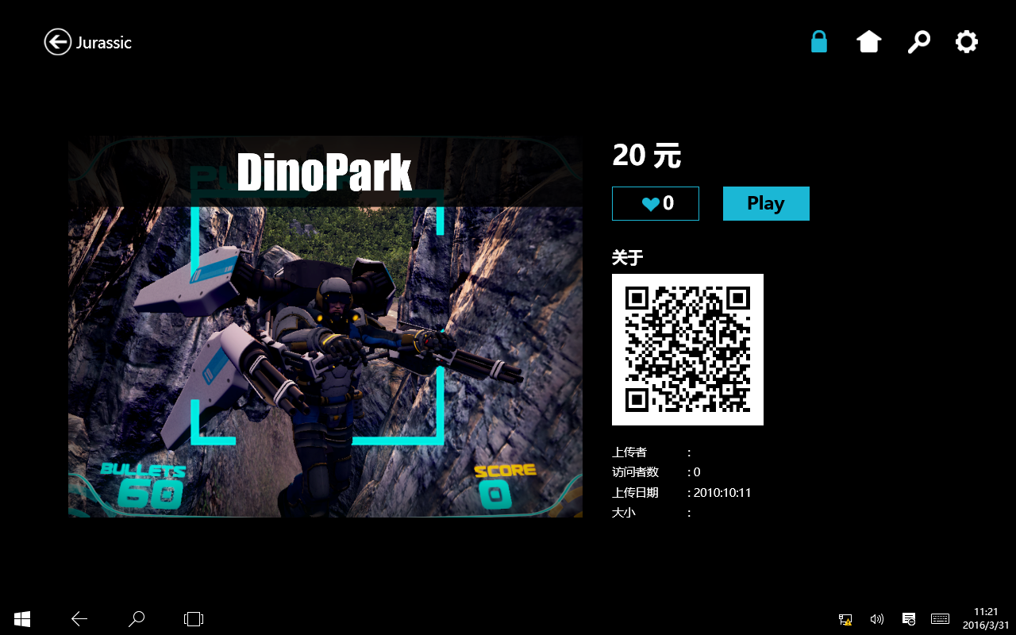



Simple mode-Game info page
Description
1. | 返回上一页Go back
2. | 游戏名称Game name
3. | 当前已选择的设备（缩略图显示） Selected game(Display by thumbnails)
4. | 游戏图片/视频 Game picture/video
5. | 游戏价格 Game price
6. | 开始游戏按钮 Start game button
7. | 游戏介绍 Game introduction 游戏相关属性 Game information 游戏开发者（内容提供者/制作者/上传者） Developer/Upload by 适用年龄段 Suit age 文件大小 File size 上传日期 Upload date 版本号 Game version 运行次数 Run times
8. | 会员登录二维码 Member scan the QR code to Log in
9. | 其他方式登录/支付 Others login and payment way
1
2
3
4
5
6
Play
7
游戏介绍
EC-1
SAFJSHDFKJAHDSJFKDSAHKJASJHDFLKJASDHFKJDSAFHAKJSHFKJDSAFHSAKJDSAFJSHDFKJAHDSJFKDSAHKJASJHDFLKJASDHFKJDSAFHAKJSHFKJDSAFHSAKJD
8
使用87APP
扫描二维码支付
9
其他方式登录/支付

Slide 10
Simple mode-1st Game & 2nd Device
Description
1. | 选择游戏类别 Select game type
2. | 选择游戏 Select game
Game
Device
2
HOT
EC-1
1
EC-2
类型1
EC-3
类型2
EC-4
类型3
EC-5
……
EC-6
ALL

Slide 11
Simple mode-Game info page
Description
1. | 选择设备 Select device
1
Device
Play
EC-1
游戏介绍
EC-2
SAFJSHDFKJAHDSJFKDSAHKJASJHDFLKJASDHFKJDSAFHAKJSHFKJDSAFHSAKJDSAFJSHDFKJAHDSJFKDSAHKJASJHDFLKJASDHFKJDSAFHAKJSHFKJDSAFHSAKJD
EC-3
EC-4
EC-5
EC-6

Slide 12
Simple mode-Game info page
Description
1. | 返回上一页Go back
2. | 游戏名称Game name
3. | 当前已选择的设备（缩略图显示） Selected game(Display by thumbnails)
4. | 游戏图片/视频 Game picture/video
5. | 游戏价格 Game price
6. | 开始游戏按钮 Start game button
7. | 游戏介绍 Game introduction 游戏相关属性 Game information 游戏开发者（内容提供者/制作者/上传者） Developer/Upload by 适用年龄段 Suit age 文件大小 File size 上传日期 Upload date 版本号 Game version 运行次数 Run times
8. | 会员登录二维码 Member scan the QR code to Log in
9. | 其他方式登录/支付 Others login and payment way
1
2
3
4
5
6
Play
7
游戏介绍
EC-1
SAFJSHDFKJAHDSJFKDSAHKJASJHDFLKJASDHFKJDSAFHAKJSHFKJDSAFHSAKJDSAFJSHDFKJAHDSJFKDSAHKJASJHDFLKJASDHFKJDSAFHAKJSHFKJDSAFHSAKJD
8
使用87APP
扫描二维码支付
9
其他方式登录/支付

Slide 13
Thumbnails mode
Game
Device
HOT
类型1
EC-1
类型2
类型3
EC-1
……
EC-1
ALL

Slide 14
Thumbnails mode-1st Device & 2nd Game
Description
1. | 选择设备 Select device
2. | 选择游戏类别 Select game type
3. | 选择游戏 Select game
Game
Device
3
HOT
2
类型1
EC-1
类型2
类型3
1
EC-1
……
EC-1
ALL

Slide 15
Thumbnails mode-Game info page
Description
1. | 返回上一页Go back
2. | 游戏名称Game name
3. | 当前已选择的设备（缩略图显示） Selected game(Display by thumbnails)
4. | 游戏图片/视频 Game picture/video
5. | 游戏价格 Game price
6. | 开始游戏按钮 Start game button
7. | 游戏介绍 Game introduction 游戏相关属性 Game information 游戏开发者（内容提供者/制作者/上传者） Developer/Upload by 适用年龄段 Suit age 文件大小 File size 上传日期 Upload date 版本号 Game version 运行次数 Run times
8. | 会员登录二维码 Member scan the QR code to Log in
9. | 其他方式登录/支付 Others login and payment way
1
2
3
4
5
6
Play
7
游戏介绍
EC-1
SAFJSHDFKJAHDSJFKDSAHKJASJHDFLKJASDHFKJDSAFHAKJSHFKJDSAFHSAKJDSAFJSHDFKJAHDSJFKDSAHKJASJHDFLKJASDHFKJDSAFHAKJSHFKJDSAFHSAKJD
8
使用87APP
扫描二维码支付
9
其他方式登录/支付

Slide 16
Thumbnails mode-1st Game & 2nd Device
Description
1. | 选择游戏类别 Select game type
2. | 选择游戏 Select game
Game
Device
2
HOT
1
类型1
EC-1
类型2
类型3
EC-1
……
EC-1
ALL

Slide 17
Thumbnails mode-1st Game & 2nd Device
Description
1. | 选择设备 Select device
Device
Play
游戏介绍
EC-1
SAFJSHDFKJAHDSJFKDSAHKJASJHDFLKJASDHFKJDSAFHAKJSHFKJDSAFHSAKJDSAFJSHDFKJAHDSJFKDSAHKJASJHDFLKJASDHFKJDSAFHAKJSHFKJDSAFHSAKJD
1
EC-1
EC-1

Slide 18
Thumbnails mode-Game info page
Description
1. | 返回上一页Go back
2. | 游戏名称Game name
3. | 当前已选择的设备（缩略图显示） Selected game(Display by thumbnails)
4. | 游戏图片/视频 Game picture/video
5. | 游戏价格 Game price
6. | 开始游戏按钮 Start game button
7. | 游戏介绍 Game introduction 游戏相关属性 Game information 游戏开发者（内容提供者/制作者/上传者） Developer/Upload by 适用年龄段 Suit age 文件大小 File size 上传日期 Upload date 版本号 Game version 运行次数 Run times
8. | 会员登录二维码 Member scan the QR code to Log in
9. | 其他方式登录/支付 Others login and payment way
1
2
3
4
5
6
Play
7
游戏介绍
EC-1
SAFJSHDFKJAHDSJFKDSAHKJASJHDFLKJASDHFKJDSAFHAKJSHFKJDSAFHSAKJDSAFJSHDFKJAHDSJFKDSAHKJASJHDFLKJASDHFKJDSAFHAKJSHFKJDSAFHSAKJD
8
使用87APP
扫描二维码支付
9
其他方式登录/支付

Slide 19
Member pay and log in by 87 App
Description
1. | 会员使用87APP扫描二维码支付&登录 Member scan the QR code to pay and Log in by 87 APP 可选操作 Optional operation
Play
游戏介绍
EC-1
SAFJSHDFKJAHDSJFKDSAHKJASJHDFLKJASDHFKJDSAFHAKJSHFKJDSAFHSAKJDSAFJSHDFKJAHDSJFKDSAHKJASJHDFLKJASDHFKJDSAFHAKJSHFKJDSAFHSAKJD
1
使用87APP
扫描二维码支付
其他方式登录/支付

Slide 20
Member paying and logging in
Description
1. | 会员登录&支付中，其他功能暂不可用 Pop up “Member logging in and paying”, other function temporarily unavailable
1
Play
Play
EC-3
提示
EC-1
游戏介绍
游戏介绍
SAFJSHDFKJAHDSJFKDSAHKJASJHDFLKJASDHFKJDSAFHAKJSHFKJDSAFHSAKJDSAFJSHDFKJAHDSJFKDSAHKJASJHDFLKJASDHFKJDSAFHAKJSHFKJDSAFHSAKJD
SAFJSHDFKJAHDSJFKDSAHKJASJHDFLKJASDHFKJDSAFHAKJSHFKJDSAFHSAKJDSAFJSHDFKJAHDSJFKDSAHKJASJHDFLKJASDHFKJDSAFHAKJSHFKJDSAFHSAKJD
正在登录&支付…
使用87APP
扫描二维码支付
其他方式登录/支付
扫描二维码登录

Slide 21
Member log in and payment failed
Description
1. | 登录&支付失败提示 Log in and payment failed prompt
2. | 返回按钮，点击返回至游戏页面 Go back button, click to go back Game page
1
Play
Play
EC-3
提示
EC-1
游戏介绍
游戏介绍
SAFJSHDFKJAHDSJFKDSAHKJASJHDFLKJASDHFKJDSAFHAKJSHFKJDSAFHSAKJDSAFJSHDFKJAHDSJFKDSAHKJASJHDFLKJASDHFKJDSAFHAKJSHFKJDSAFHSAKJD
SAFJSHDFKJAHDSJFKDSAHKJASJHDFLKJASDHFKJDSAFHAKJSHFKJDSAFHSAKJDSAFJSHDFKJAHDSJFKDSAHKJASJHDFLKJASDHFKJDSAFHAKJSHFKJDSAFHSAKJD
登录&支付失败
2
返回
使用87APP
扫描二维码支付
其他方式登录/支付
扫描二维码登录

Slide 22
Member log in and payment failed
1
Description
1. | 游戏页面 Game page
Play
Play
EC-3
游戏介绍
EC-1
游戏介绍
SAFJSHDFKJAHDSJFKDSAHKJASJHDFLKJASDHFKJDSAFHAKJSHFKJDSAFHSAKJDSAFJSHDFKJAHDSJFKDSAHKJASJHDFLKJASDHFKJDSAFHAKJSHFKJDSAFHSAKJD
SAFJSHDFKJAHDSJFKDSAHKJASJHDFLKJASDHFKJDSAFHAKJSHFKJDSAFHSAKJDSAFJSHDFKJAHDSJFKDSAHKJASJHDFLKJASDHFKJDSAFHAKJSHFKJDSAFHSAKJD
使用87APP
扫描二维码支付
其他方式登录/支付
扫描二维码登录

Slide 23

Member has logged
Description
1. | 会员头像 Member head portrait
2. | 会员昵称 Member nickname
3. | 会员积分 Integration
4. | 退出登录 Log out
5. | 点击“其他方式登录/支付”按钮，可查看当前登录及支付信息 Click “Others way to log in and payment” button, member can view log in and payment infomation
Play
游戏介绍
EC-1
SAFJSHDFKJAHDSJFKDSAHKJASJHDFLKJASDHFKJDSAFHAKJSHFKJDSAFHSAKJDSAFJSHDFKJAHDSJFKDSAHKJASJHDFLKJASDHFKJDSAFHAKJSHFKJDSAFHSAKJD
1
2
Username
3
Integration
4
Log out
5
其他方式登录/支付

Slide 24
Member has logged
登录 & 支付
Description
1. | 用户登录后（包括87APP扫描二维码登录及输入用户名密码登录），在登录&支付页面，输入用户名/密码区域变为用户信息及退出登录按钮。 After member has logged(include 87APP scan QR code log in and input username/password log in), then in log in and payment page the input box 用户信息包括： User information include: 用户头像Member head portrait 用户昵称Member nickname 用户积分Integration 退出登录按钮Log out button
2. | 用户支付信息 Member payment information 支付方式Payment way 支付金额Payment amount
1
Username
Integration
Log out
游戏介绍
SAFJSHDFKJAHDSJFKDSAHKJASJHDFLKJASDHFKJDSAFHAKJSHFKJDSAFHSAKJDSAFJSHDFKJAHDSJFKDSAHKJASJHDFLKJASDHFKJDSAFHAKJSHFKJDSAFHSAKJD
2
支付成功
支付方式：87 APP
支付金额：￥30.00元

Slide 25
Member pay and log in by others
Description
1. | 点击“其他方式登录/支付”按钮，进入其他方式登录/支付页面。 Click “Others way to log in and pay” button to enter the page.
Play
游戏介绍
EC-1
SAFJSHDFKJAHDSJFKDSAHKJASJHDFLKJASDHFKJDSAFHAKJSHFKJDSAFHSAKJDSAFJSHDFKJAHDSJFKDSAHKJASJHDFLKJASDHFKJDSAFHAKJSHFKJDSAFHSAKJD
使用87APP
扫描二维码支付
1
其他方式登录/支付

Slide 26


Others way to log in and pay
1
登录 & 支付
Description
1. | 登录&支付页面，从屏幕右侧滑出 Log in and payment page, this page swipe by right like windows 8 notification center.
2. | 用户名&密码输入框 Input box: Username and password
3. | “登录并返回游戏页面”按钮 Button: “Log in and go back game page”
4. | “登录后支付”按钮 Button: “After logging in payment”
5. | 支付宝支付二维码 QR code for pay by Alipay
6. | 微信支付二维码 QR code for pay by Wechat
2
用户名
密码
登录并返回游戏页面
3
登录后支付
4
游戏介绍
SAFJSHDFKJAHDSJFKDSAHKJASJHDFLKJASDHFKJDSAFHAKJSHFKJDSAFHSAKJDSAFJSHDFKJAHDSJFKDSAHKJASJHDFLKJASDHFKJDSAFHAKJSHFKJDSAFHSAKJD
使用支付宝/微信APP扫码支付
5
6
支付宝
微信

Slide 27
Log in by username and password
登录 & 支付
Description
1. | 用户名/密码输入框 Username/Password input box
2. | 用户名/密码输入错误提示 Username/Password error message
3. | “登录并返回游戏页面”按钮，点击登录后返回游戏界面（用于现金支付） “Log in and go back game page”, click it member log in and then go back game page(for pay by cash)
4. | “登录后支付”按钮，点击登陆后留在此页面，用户可选择支付宝/微信支付（用户支付宝/微信支付） “After log in payment” button, click it member log in and stay this page, member can scan QR code to pay by Alipay or Wechat(for pay by Alipay and Wechat)
1
用户名
2
Error message
密码
Error message
登录并返回游戏页面
3
登录后支付
4
游戏介绍
SAFJSHDFKJAHDSJFKDSAHKJASJHDFLKJASDHFKJDSAFHAKJSHFKJDSAFHSAKJDSAFJSHDFKJAHDSJFKDSAHKJASJHDFLKJASDHFKJDSAFHAKJSHFKJDSAFHSAKJD
使用支付宝/微信APP扫码支付
支付宝
微信

Slide 28
Go back game page
Description
1. | 用户信息 Member information 用户头像Member head portrait 用户昵称Member nickname 积分Integration
2. | “退出登录”按钮，点击退出登录 Click “Log out” button to log out
3. | 点击“其他方式登录/支付”按钮，进入其他方式登录/支付页面。 Click “Others way to log in and pay” button to enter the page.
Play
游戏介绍
EC-1
SAFJSHDFKJAHDSJFKDSAHKJASJHDFLKJASDHFKJDSAFHAKJSHFKJDSAFHSAKJDSAFJSHDFKJAHDSJFKDSAHKJASJHDFLKJASDHFKJDSAFHAKJSHFKJDSAFHSAKJD
1
Username
Integration
Log out
2
3
其他方式登录/支付

Slide 29
Stay log in and payment page for payment
登录 & 支付
Description
1. | 用户使用支付宝/微信APP扫描二维码支付 Member scan QR code by Alipay or Wechat for payment
Username
Integration
Log out
游戏介绍
SAFJSHDFKJAHDSJFKDSAHKJASJHDFLKJASDHFKJDSAFHAKJSHFKJDSAFHSAKJDSAFJSHDFKJAHDSJFKDSAHKJASJHDFLKJASDHFKJDSAFHAKJSHFKJDSAFHSAKJD
使用支付宝/微信APP扫码支付
1
支付宝
微信

Slide 30
Payment successful
登录 & 支付
Description
1. | 支付成功后，支付方式变为支付状态机支付信息 After payment successful, payment way change to payment status and payment information 支付信息包括: Payment information include: 支付方式Payment way 支付金额Payment amount
Username
Integration
Log out
游戏介绍
SAFJSHDFKJAHDSJFKDSAHKJASJHDFLKJASDHFKJDSAFHAKJSHFKJDSAFHSAKJDSAFJSHDFKJAHDSJFKDSAHKJASJHDFLKJASDHFKJDSAFHAKJSHFKJDSAFHSAKJD
1
支付成功
支付方式：支付宝
支付金额：￥30.00元

Slide 31
Payment failed
登录 & 支付
Description
1. | 支付失败提示 Payment failed prompt
2. | 点击“返回”按钮，返回登录&支付页面 Click “Back” button, go back log in and payment page
Username
1
Integration
提示
Log out
游戏介绍
SAFJSHDFKJAHDSJFKDSAHKJASJHDFLKJASDHFKJDSAFHAKJSHFKJDSAFHSAKJDSAFJSHDFKJAHDSJFKDSAHKJASJHDFLKJASDHFKJDSAFHAKJSHFKJDSAFHSAKJD
支付失败
2
使用支付宝/微信APP扫码支付
返回
支付宝
微信

Slide 32
Payment failed
1
登录 & 支付
Description
1. | 支付失败，点击“返回”按钮，返回登录&支付页面 After payment failed, click “Back” button, go back log in and payment page
Username
Integration
Log out
游戏介绍
SAFJSHDFKJAHDSJFKDSAHKJASJHDFLKJASDHFKJDSAFHAKJSHFKJDSAFHSAKJDSAFJSHDFKJAHDSJFKDSAHKJASJHDFLKJASDHFKJDSAFHAKJSHFKJDSAFHSAKJD
使用支付宝/微信APP扫码支付
支付宝
微信

Slide 33
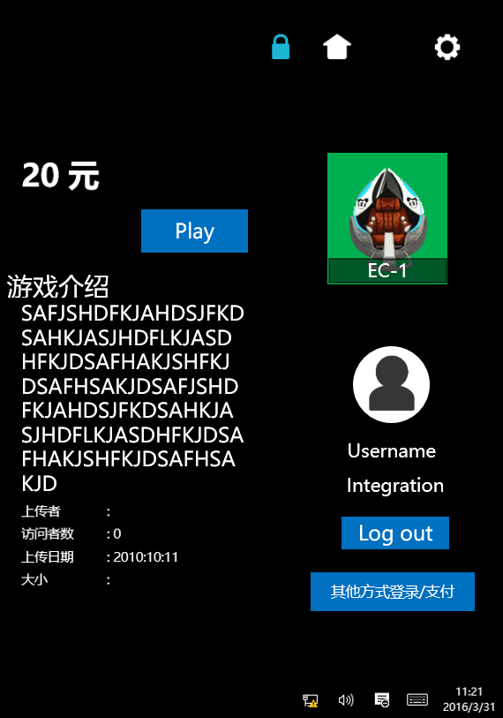
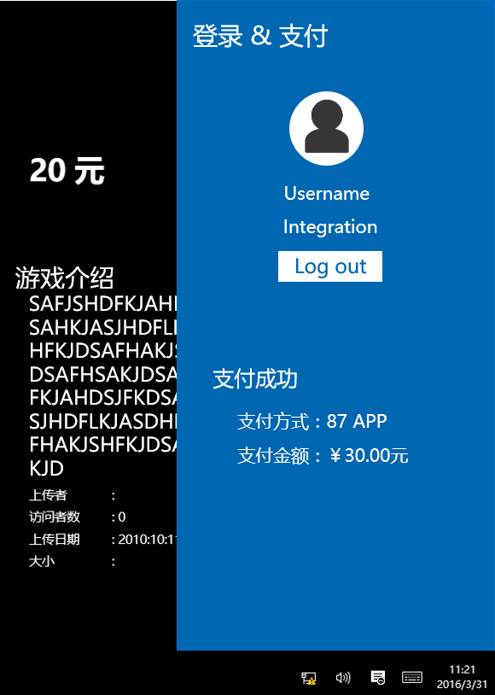
Member log out
Description
1. | 点击“退出登录”按钮，退出登录 Click “Log out” button to log out “退出登录”按钮包括： “Log out” button include: 游戏页面的“退出登录”按钮 “Log out” button in game page 登录&支付页面的“退出登录”按钮 “Log out” button in log in and payment page
1

Slide 34
Member log out
Description
1. | 退出登录确认提示 Log out prompt
2. | 点击“确定”按钮，确认退出登录 Click “OK” button to confirm log out
3. | 点击“取消”按钮，取消退出登录 Click “Cancel” button to cancel log out
1
Play
提示
EC-1
游戏介绍
SAFJSHDFKJAHDSJFKDSAHKJASJHDFLKJASDHFKJDSAFHAKJSHFKJDSAFHSAKJDSAFJSHDFKJAHDSJFKDSAHKJASJHDFLKJASDHFKJDSAFHAKJSHFKJDSAFHSAKJD
确定退出登录吗？
2
3
确定
取消
Username
Integration
Log out
其他方式登录/支付

Slide 35
Member log out
Description
1. | 会员退出登录后，会员信息恢复为登录二维码 After member log out, the member information changes to log in QR code
Play
游戏介绍
EC-1
SAFJSHDFKJAHDSJFKDSAHKJASJHDFLKJASDHFKJDSAFHAKJSHFKJDSAFHSAKJDSAFJSHDFKJAHDSJFKDSAHKJASJHDFLKJASDHFKJDSAFHAKJSHFKJDSAFHSAKJD
1
使用87APP
扫描二维码支付
其他方式登录/支付

Slide 36
Member log out
1
登录 & 支付
Description
1. | 会员退出登录后，登录&支付页面恢复为初始状态 After member log out, log in and payment page change to default status
用户名
密码
登录并返回游戏页面
登录后支付
游戏介绍
SAFJSHDFKJAHDSJFKDSAHKJASJHDFLKJASDHFKJDSAFHAKJSHFKJDSAFHSAKJDSAFJSHDFKJAHDSJFKDSAHKJASJHDFLKJASDHFKJDSAFHAKJSHFKJDSAFHSAKJD
使用支付宝/微信APP扫码支付
支付宝
微信

Slide 37
Only payment by Alipay or Wechat and not log in
Description
1. | 点击“其他方式登录/支付”按钮，进入其他方式登录&支付页面 Click “Others way to log in and payment” button enter Others way to log in and payment page
Play
游戏介绍
EC-1
SAFJSHDFKJAHDSJFKDSAHKJASJHDFLKJASDHFKJDSAFHAKJSHFKJDSAFHSAKJDSAFJSHDFKJAHDSJFKDSAHKJASJHDFLKJASDHFKJDSAFHAKJSHFKJDSAFHSAKJD
使用87APP
扫描二维码支付
1
其他方式登录/支付

Slide 38
Only payment by Alipay or Wechat and not log in
登录 & 支付
Description
1. | 用户使用支付宝/微信APP扫描二维码支付 Member scan QR code by Alipay or Wechat for payment
用户名
密码
登录并返回游戏页面
登录后支付
游戏介绍
SAFJSHDFKJAHDSJFKDSAHKJASJHDFLKJASDHFKJDSAFHAKJSHFKJDSAFHSAKJDSAFJSHDFKJAHDSJFKDSAHKJASJHDFLKJASDHFKJDSAFHAKJSHFKJDSAFHSAKJD
使用支付宝/微信APP扫码支付
1
支付宝
微信

Slide 39
Payment successful
登录 & 支付
Description
1. | 支付成功后，支付方式变为支付状态机支付信息 After payment successful, payment way change to payment status and payment information 支付信息包括: Payment information include: 支付方式Payment way 支付金额Payment amount
用户名
密码
登录并返回游戏页面
登录后支付
游戏介绍
SAFJSHDFKJAHDSJFKDSAHKJASJHDFLKJASDHFKJDSAFHAKJSHFKJDSAFHSAKJDSAFJSHDFKJAHDSJFKDSAHKJASJHDFLKJASDHFKJDSAFHAKJSHFKJDSAFHSAKJD
1
支付成功
支付方式：支付宝
支付金额：￥30.00元

Slide 40
Payment failed
登录 & 支付
Description
1. | 支付失败提示 Payment failed prompt
2. | 点击“返回”按钮，返回登录&支付页面 Click “Back” button, go back log in and payment page
用户名
密码
登录并返回游戏页面
1
登录后支付
提示
游戏介绍
SAFJSHDFKJAHDSJFKDSAHKJASJHDFLKJASDHFKJDSAFHAKJSHFKJDSAFHSAKJDSAFJSHDFKJAHDSJFKDSAHKJASJHDFLKJASDHFKJDSAFHAKJSHFKJDSAFHSAKJD
支付失败
2
使用支付宝/微信APP扫码支付
返回
支付宝
微信

Slide 41
Payment failed
1
登录 & 支付
Description
1. | 支付失败，点击“返回”按钮，返回登录&支付页面 After payment failed, click “Back” button, go back log in and payment page
用户名
密码
登录并返回游戏页面
登录后支付
游戏介绍
SAFJSHDFKJAHDSJFKDSAHKJASJHDFLKJASDHFKJDSAFHAKJSHFKJDSAFHSAKJDSAFJSHDFKJAHDSJFKDSAHKJASJHDFLKJASDHFKJDSAFHAKJSHFKJDSAFHSAKJD
使用支付宝/微信APP扫码支付
支付宝
微信

Slide 42
Start game
Description
1. | 点击“开始”按钮，游戏开始 Click “Play” button to play game.
1
Play
游戏介绍
EC-1
SAFJSHDFKJAHDSJFKDSAHKJASJHDFLKJASDHFKJDSAFHAKJSHFKJDSAFHSAKJDSAFJSHDFKJAHDSJFKDSAHKJASJHDFLKJASDHFKJDSAFHAKJSHFKJDSAFHSAKJD
Username
Integration
Log out
其他方式登录/支付

Slide 43
Game running
Description
1. | 游戏进行中，设备变为正在运行状态（红色） Game running, the device status change to running(Red)
2. | 游戏进行中，此按钮不可用 Game in progress，and this button is invalid.
1
2
续费继续
停止
Play
游戏介绍
EC-1
SAFJSHDFKJAHDSJFKDSAHKJASJHDFLKJASDHFKJDSAFHAKJSHFKJDSAFHSAKJDSAFJSHDFKJAHDSJFKDSAHKJASJHDFLKJASDHFKJDSAFHAKJSHFKJDSAFHSAKJD
Username
Integration
Log out
其他方式登录/支付

Slide 44
Pay and continue
Description
1. | 游戏死亡或关卡结束，则“游戏进行中按钮”变为“续费继续按钮” The character dies or level end, the “Game in progress” button changes to “Pay and continue” button. 续费继续：点击续费继续后，继续体验游戏。（如果在之前的游戏中死亡，续费后复活继续游戏，若关卡结束，续费后继续体验下一关卡） Pay and continue: Click “Pay and continue” button，The game will be play continue.(if character dies in the game, pay and resurrection to play game. If level end, pay and continue play the next level).
1
续费继续
续费继续
停止
Play
游戏介绍
EC-1
SAFJSHDFKJAHDSJFKDSAHKJASJHDFLKJASDHFKJDSAFHAKJSHFKJDSAFHSAKJDSAFJSHDFKJAHDSJFKDSAHKJASJHDFLKJASDHFKJDSAFHAKJSHFKJDSAFHSAKJD
Username
Integration
Log out
其他方式登录/支付

Slide 45
Pay and continue
Description
1. | 用户选择续费继续后，之前选择87APP扫码支付的用户，用户登录信息变为二维码，用于用户使用87APP扫码支付（第一次的登录信息可在登录&支付页面查看） After member choose Pay and continue, before member choosing to pay by 87App， member information change to QR code, member can scan the QR code for payment by 87APP(Member first time log in information still in the log in and payment page)
续费继续
停止
Play
游戏介绍
EC-1
SAFJSHDFKJAHDSJFKDSAHKJASJHDFLKJASDHFKJDSAFHAKJSHFKJDSAFHSAKJDSAFJSHDFKJAHDSJFKDSAHKJASJHDFLKJASDHFKJDSAFHAKJSHFKJDSAFHSAKJD
1
使用87APP
扫描二维码支付
其他方式登录/支付

Slide 46
Pay and continue
登录 & 支付
Description
1. | 用户选择续费继续后，之前选择支付宝/微信支付的用户，登录&支付页面中的支付信息恢复为支付二维码，用于用户扫码支付 After member choose Pay and continue, before member choosing to pay by Alipay or Wechat, now in log in and payment page the payment information change to payment QR code, member can scan the QR code for payment by Alipay or Wechat
Username
续费继续
Integration
Log out
游戏介绍
SAFJSHDFKJAHDSJFKDSAHKJASJHDFLKJASDHFKJDSAFHAKJSHFKJDSAFHSAKJDSAFJSHDFKJAHDSJFKDSAHKJASJHDFLKJASDHFKJDSAFHAKJSHFKJDSAFHSAKJD
1
使用支付宝/微信APP扫码支付
支付宝
微信

Slide 47
Stop game-1
Description
1. | 在游戏进行过程中，可点击“停止”按钮，停止游戏 When gaming, can click “Stop” button to stop the game.
1
续费继续
续费继续
停止
Play
游戏介绍
EC-1
SAFJSHDFKJAHDSJFKDSAHKJASJHDFLKJASDHFKJDSAFHAKJSHFKJDSAFHSAKJDSAFJSHDFKJAHDSJFKDSAHKJASJHDFLKJASDHFKJDSAFHAKJSHFKJDSAFHSAKJD
Username
Integration
Log out

Slide 48
Stop game-2
Description
1. | 确认停止游戏提示 Confirm info
2. | 点击“确认”按钮，确认停止 Click “OK” button, confirm to stop the game.
3. | 点击“取消”按钮，取消停止游戏（不停止） Click “Cancel” button, cancel stop the game.
续费继续
续费继续
续费继续
停止
停止
1
Play
提示
EC-1
游戏介绍
SAFJSHDFKJAHDSJFKDSAHKJASJHDFLKJASDHFKJDSAFHAKJSHFKJDSAFHSAKJDSAFJSHDFKJAHDSJFKDSAHKJASJHDFLKJASDHFKJDSAFHAKJSHFKJDSAFHSAKJD
确认停止游戏吗？
2
3
确定
取消
Username
Integration
Log out
其他方式登录/支付

Slide 49
Game over-1
Description
1. | 游戏正常结束后，出现“游戏结束”按钮，点击此按钮，游戏结束，此按钮变为“Play”设备重置为“空闲”状态。若用户想再体验一次次游戏，只需点击“Play”按钮即可 The game over normally, show “Game over” button, click this button, game end, and this button changes to “Play” button and this device changes to “Free” status. If member wants to play again, Only need to click this “Play” button
1
游戏结束
Play
游戏介绍
EC-1
SAFJSHDFKJAHDSJFKDSAHKJASJHDFLKJASDHFKJDSAFHAKJSHFKJDSAFHSAKJDSAFJSHDFKJAHDSJFKDSAHKJASJHDFLKJASDHFKJDSAFHAKJSHFKJDSAFHSAKJD
Username
Integration
Log out
其他方式登录/支付

Slide 50
Game over-2
Description
1. | 此时设备为“空闲”状态。 Now this device is “Free” status（Green）
2. | 若用户想再体验一次次游戏，只需点击“Play”按钮即可 If member wants to play again, Only need to click this “Play” button
2
1
Play
Play
游戏介绍
EC-1
SAFJSHDFKJAHDSJFKDSAHKJASJHDFLKJASDHFKJDSAFHAKJSHFKJDSAFHSAKJDSAFJSHDFKJAHDSJFKDSAHKJASJHDFLKJASDHFKJDSAFHAKJSHFKJDSAFHSAKJD
Username
Integration
Log out
其他方式登录/支付

Slide 51
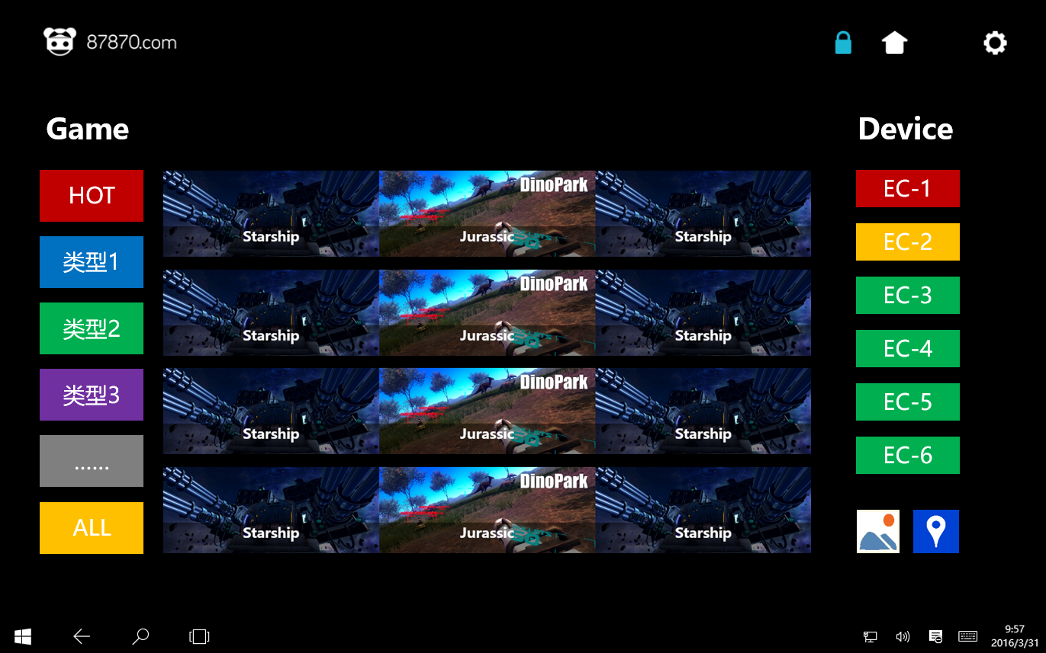
Settings-1
Description
1. | 点击“设置”按钮，进入设置页面 Click “Settings” button, enter settings page.
1
Game

Slide 52
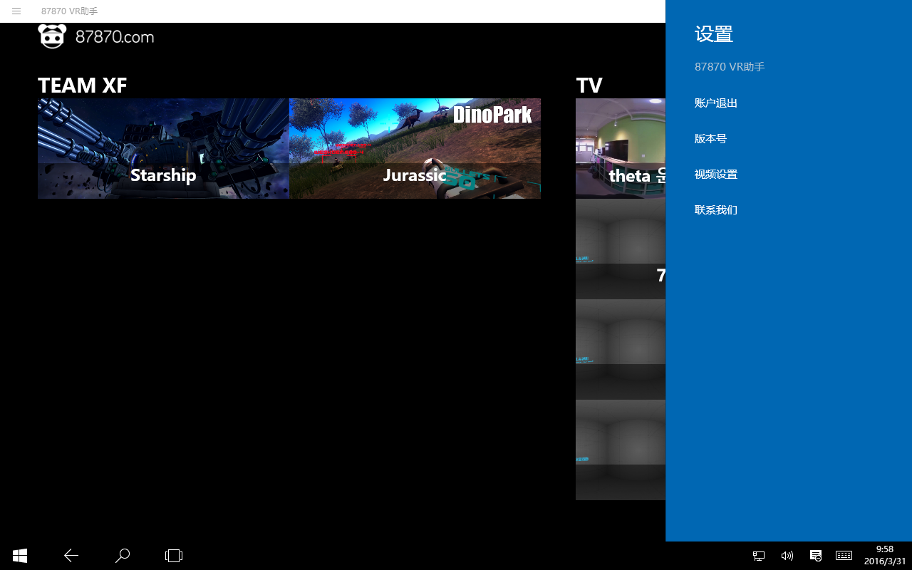
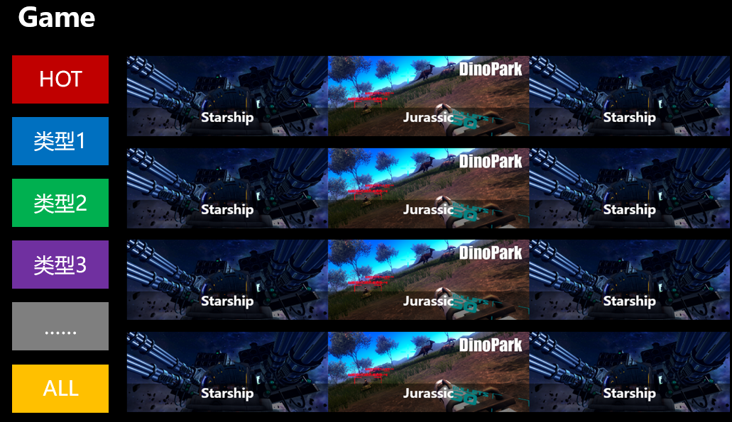
Settings-2
1
Description
1. | 设置列表 Settings list
设备管理

Slide 53
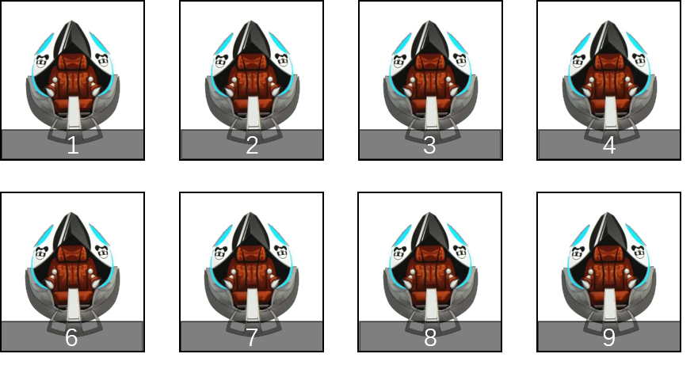
Settings [Device management]
Description
1. | 点击“设备管理”，进入设备管理页面 Click “Contact us” to check contact information.
1
设备管理

Slide 54


Device Management
Description
1. | 已绑定设备列表 Bound devices list
2. | 上下滑动 Swipe up to down
3. | 输入绑定设备的IP Enter device PC IP
4. | 绑定设备名称 Device rename
5. | 设备类型 Device type 蛋椅Egg chair 模拟器Simulator ……
6. | 设备状态 Device Status 正常Normal 停用Disable
7. | 绑定信息预览 Banding Preview 设备图标Device icon 设备名称Device name
8. | 测试按钮，点击测试按钮，检测当前输入的绑定信息是否有误 Test button，Click it to check the enter or select info is right or not.
9. | 点击“绑定”按钮，设备与前端控制器绑定 Click “Bind” button， the device binding with control panel.
Device Mgt.
1
2
Bound Devices
Binding Devices
3
Device PC IP：
7
4
Rename:
1
2
5
Type:
6
Status:
Rename
3
4
8
9
Test
Binding

Slide 55
Device Management [Binding]
Description
1. | 设备绑定成功提示 Binding successful prompt
2. | 返回首页按钮，点击返回首页 Go back Home page button, Click it can be go back Home page
3. | 返回设备管理页按钮，点击返回设备管理页 Go back Device Mgt. page button, Click it can be go back Device Mgt. page
Device Mgt.
Bound Devices
Binding Devices
1
Device PC IP：
Test
提示
设备绑定成功！
Rename:
1
2
2
3
Type:
返回首页
返回设备管理页
Status:
Rename
3
4
Binding

Slide 56
Device Management [Test]
Description
1. | 点击“检测”按钮，检测当前录入信息时候正确 Click “Test” button to check the enter information is right or not.
2. | 录入信息错误提示 Error message IP错误提示包含： IP error message include: 输入的IP地址已被绑定 This IP has been bound 输入的IP地址无效 This is a invalid IP Rename错误提示包含： Rename error message include: 此名称已被占用 This name is already being used
Device Mgt.
Bound Devices
Binding Devices
Device PC IP：
2
Error message
Rename:
1
2
Error message
Type:
Status:
Rename
3
4
1
Test
Binding

Slide 57
Device Management [View bound]
Description
1. | 点击被绑定的设备，进入设备信息页，可查看及修改信息。 Click bound device, enter Bound device information page to view or modify bound information.
Device Mgt.
Bound Devices
Binding Devices
1
Device PC IP：
Rename:
1
2
Type:
Status:
Rename
3
4
Test
Binding

Slide 58
Device Management [Update-1]
Description
1. | 设备当前配置信息 Device information
2. | 设备名称更新 Rename device
3. | 设备类型更新 Update device type
4. | 设备状态更新 Update device status
5. | 更新预览 Update preview
6. | 录入信息错误提示 Error message Rename错误提示包含： Rename error message include: 此名称已被占用 This name is already being used
7. | 测试按钮，点击测试按钮，检测当前输入的绑定信息是否有误 Test button，Click it to check the enter or select info is right or not.
8. | 点击“更新”按钮，完成更新 Click “Update” button to update bound information
9. | 点击取消绑定按钮，取消设备绑定 Click “Unbind” button to unbind device with control panel
Device Mgt.
Device Information
Update
5
1
Device Name：Name 1
2
Rename:
Device Type：Egg Chair
Error message
Device Status：Normal
3
Type:
Device PC IP：192.168.1.101
4
Status:
Rename
6
7
8
Unbind
Test
Update
9

Slide 59
Device Management [Update-2]
Description
1. | 更新成功提示 Update successful prompt
2. | 返回首页按钮，点击返回首页 Go back Home page button, Click it can be go back Home page
3. | 返回设备管理页按钮，点击返回设备管理页 Go back Device Mgt. page button, Click it can be go back Device Mgt. page
Device Mgt.
Device Information
Update
1
Device Name：Name 1
提示
Rename:
Device Type：Egg Chair
更新成功！
Type:
Device Status：Normal
2
3
Device PC IP：PC Name 1
Status:
返回首页
返回设备管理页
Rename
Unbind
Test
Update

Slide 60
Device Management [Unbind-1]
Description
1. | 点击取消绑定按钮，取消设备绑定 Click “Unbind” button to unbind device with control panel
Device Mgt.
Device Information
Update
Device Name：Name 1
Rename:
Device Type：Egg Chair
更新成功！
Type:
Device Status：Normal
Device PC IP：PC Name 1
Status:
Rename
1
Unbind
Test
Update

Slide 61
Device Management [Unbind-2]
Description
1. | 确认取消绑定提示 Confirm to unbind prompt
2. | 点击“确定并返回首页”按钮，确认取消绑定并返回首页 Click “OK and go back Home page” button, confirm to unbind and go back Home page
3. | 点击“确定并返回设备管理页”按钮，确认取消绑定并返回设备管理页 Click “OK and go back Device Mgt. page” button, confirm to unbind and go back Device Mgt. page
4. | 点击“取消”按钮，不取消绑定 Click “Cancel” button, don’t unbind
Device Mgt.
1
提示
Device Info Update
Renderings
确定取消绑定吗？
Device Name：Name 1
Device Type：Egg Chair
2
确定并返回首页
Device Status：Normal
3
确定并返回设备管理页
Device PC Name：PC Name 1
Device PC Mac：aa-aa-aa-aa-aa-aa
4
取消
Rename:
Rename
Type:
Status:
Unbind
Update

Slide 62
Settings [Log out-1]
Description
1. | 点击“账户退出”返回登录页 Click “Log out”, log out and go back Log in page.
1
设备管理

Slide 63
Settings [Log out-2]
Description
1. | 登录页 Log in page
1

Slide 64
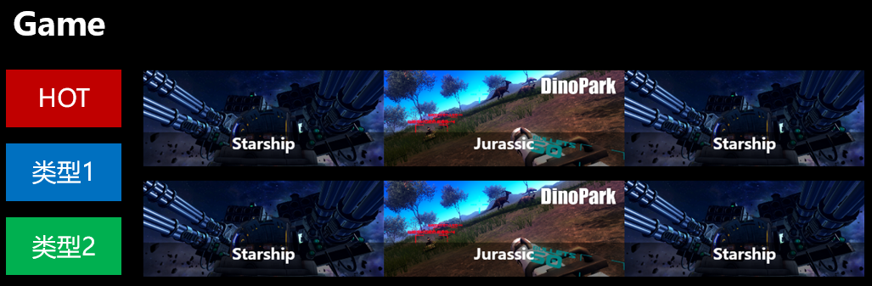
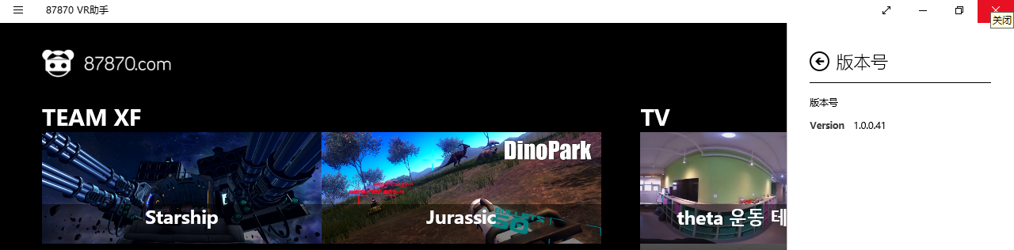
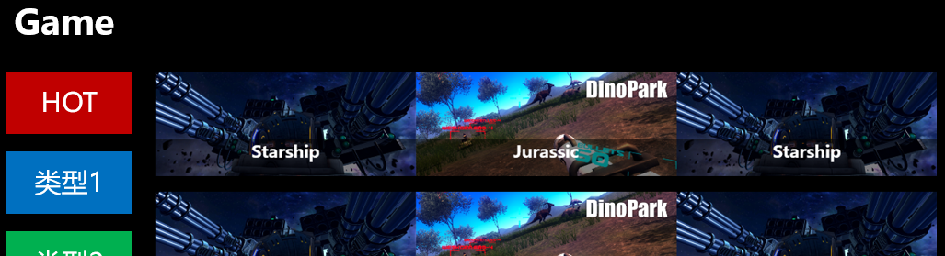
Settings [Version]
Description
1. | 点击“版本号”查看当前87V8（VR World）版本号 Click “Version” to check 87V8（VR World） current version.
2. | 87V8（VR World）版本号 The 87V8（VR World）version
1
设备管理
2

Slide 65
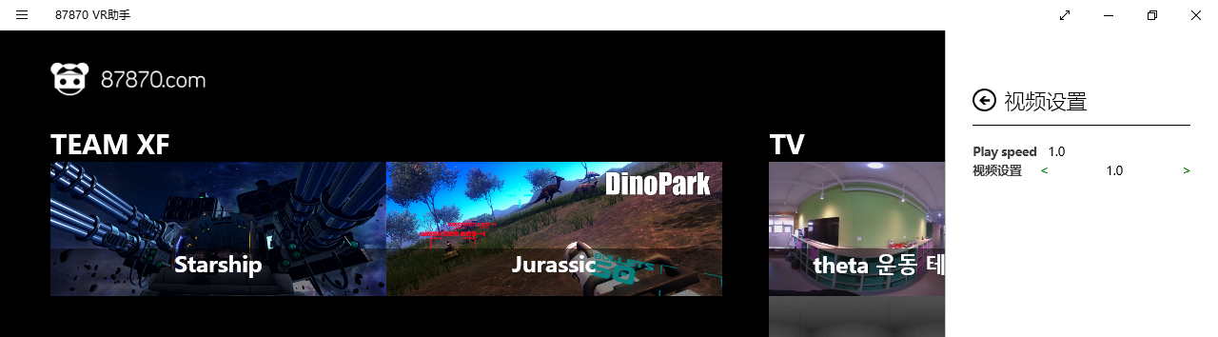
Settings [Video settings]
Description
1. | 点击“视频设置”，进入视频设置 Click “Video Settings”, enter video settings page.
2. | 设置视频播放速度 Set the play speed.
1
设备管理
Game
2

Slide 66
Settings [Contact us]
Description
1. | 点击“联系我们”，查看联系方式 Click “Contact us” to check contact information.
2. | 联系方式 Contact information
1
设备管理
2
联系我们
Game
电话：010-88888888

Slide 67
Thank you！
Oliver Wang
Happy Online Planning Team

